Slide 1
TCS Interact Club 2014-15
Faculty Sponsors:
Lynn Haas and Ali Mills

Slide 2
Did your club undertake any projects to serve the school or community? If so, please describe all of your projects and include the number of students, teachers and Rotarians involved.

Slide 3
Projects
In addition to the fundraisers in Question 3
Presentation on human trafficking to the whole school in October
Cokkie Eaker came from Rotary to present to our Middle School Students
Roswell High School Interact Club came to present to our High School students
Participated in the Roswell Youth Day Parade

Slide 4
Did your club participate in an activity or project to promote international understanding? If so, please describe and include the number of students, teachers and Rotarians involved.

Slide 5
International Project
On February 22nd Jim Coyle will be presenting about Honduras to our club
We will plan a project to help Rotary with their project in Honduras after this presentation

Slide 6
Did your club organize a successful fundraiser? If so, please describe and include the number of students, teachers and Rotarians involved and how much money was raised and how it was used.

Slide 7
Successful Fundraisers
Relay for Life
Raised $1,500
Sold 80 boxes of donuts and other fundraisers to raise the money for Relay
Shoe drive to benefit the homeless adults and children in Atlanta
All students and staff members donated items
Over 200 pairs of shoes were collected
Toy and Coat Drive to benefit NFCC
All students and staff members donated items
1 Rotarian and his company added to our donation drive
Over 200 coats and over 100 toys were collected

Slide 8
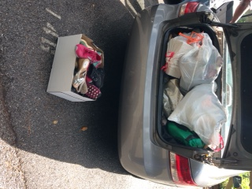
Shoe Drive

Slide 9
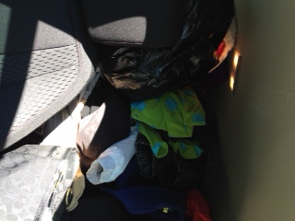
Toys and Coats

Slide 10
Did your club participate in a fundraiser to support polio eradication? If so, please describe and include the number of students, teachers and Rotarians involved and how much money was raised.

Slide 11
Polio Fundraiser
January 26 to 30 – students and teachers brought in money for Polio – the homeroom with the most money won a free lunch
All students and teachers participated
Every morning 1 fact about polio was read to all students and teachers in their homeroom
$800.00 was raised

Slide 12
Did your club participate in a career day or mentoring activity? If so, please describe and include the number of students, teachers and Rotarians involved.

Slide 13
Career Day
Each month a career speaker comes to the school or skypes with the school about their job
This year we have had the following guests
Hollywood Actress
Human Resources Manager
Medical School Student
GA Ensemble Theatre Representatives

Slide 14
Please provide a description of how the Seed Money provided by RRC was used. Please provide your thoughts on whether or not the amounts should be modified (too much, not enough).

Slide 15
Seed Money
We used our money for the following:
New club t-shirts and tie-dye for the shirts
Prizes for the willing homerooms from the Polio Drive and the Shoe Drive
Raffle prizes for donations for toys and coats
Winter Holiday party
We feel the seed money is the perfect amount and allows us to reward people for their donations and allows us to participate in activities to celebrate our club and accomplishments

